Slide 1

Reviews
Login/signUp
Become a host
Help
Contact Us
Search by city,address check In Check Out Guest
Tourist Hotspot
Mumbai
Goa
Shimla

Slide 2

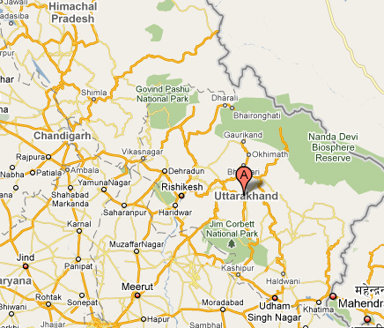
City,address check In Check Out Guest Host Help inbox userName
Room Type Entire Home private room shared room
Price Range
500
More Filters
1
2
3

Slide 3


City, address check In Check Out Guest Host Help inbox userName
Hey, I am Username
Country, member since……
About user……..
Edit profile
Reviews
Reviews from guest
………….
Reviews from host
…………
Verifed Id
Facebook
Gmail
Passport
.
.
.
Verification Score…….

Slide 4
City, address check In Check Out Guest Host Help inbox userName
Popular on DreamHalt Our Picks My Wishlist

Slide 5
City, address check In Check Out Guest Host Help inbox userName
Add Your Listing
Home Type
Appartment house bed & breakfast others
RoomType
Accomodates
Country, City
Entire Home Private Room Shared Room
1
India
Continue

Slide 6
City, address check In Check Out Guest Host Help inbox userName
Listing
Basics
Description
Location
Amenities
Home Safety
Hosting
Pricing
Booking
Calendar
Listing
Room type Property type Accomodates
Rooms and Beds
Bedrooms Beds Bathrooms
Entire Home/Apt
appartment
1
1
1
1

Slide 7
City, address check In Check Out Guest Host Help inbox userName
Tell travelers about your space
Listing Name
Summary
Photos
Back
Listing
Basics
Description
Location
Amenities
Home Safety
Hosting
Pricing
Booking
Calendar
Add photos
Next

Slide 8
City, address check In Check Out Guest Host Help inbox userName
Help guests find your place
Country
Street Address
City State
ZipCode
Back
Listing
Basics
Description
Location
Amenities
Home Safety
Hosting
Pricing
Booking
Calendar
India
Next

Slide 9
City, address check In Check Out Guest Host Help inbox userName
Common ammenities
Essentials
TV
Cable Tv
Air Conditioning
Heating
Kitchen
Internet
Additional amenities
Hot tub
Washer
Pool
Dryer
Breakfast
Back
Listing
Basics
Description
Location
Amenities
Home Safety
Hosting
Pricing
Booking
Calendar
Next

